Slide 1
Assignment-3
BITS F 312: Neural Networks & Fuzzy Logic
Submitted by:
Siddhartha Kansal - 2019A7PS0129P
Khushaal Chaba - 2020A8PS1816P
Sarthak Gupta- 2020A8PS1821P

Slide 2
Analyzing and Improving the Image Quality of StyleGAN
Authors
Tero Karras - NVIDIA
Samuli Laine -NVIDIA
Miika Aittala - NVIDIA
Janne Hellsten - NVIDIA
Jaakko Lehtinen - NVIDIA and Aalto University
Timo Aila - NVIDIA

Slide 3
Paper Description
Style based Generator(Style GAN) gives better results in data driven unconditional generative image modeling.
The generator normalization is redesigned and regularized.
This not only improves image quality but also makes it easy to detect an image generated by a particular network.

Slide 4
Introduction

Slide 5
Generative Adversarial Network (GAN)
It is a class of Machine Learning framework in which two neural networks compete with each other in the form of a zero-sum game, where one player's gain is another player's loss.
There are two networks called Generator, which generates images from noise(latent variables), and Discriminator, which distinguishes between images generated by Generator and real images.

Slide 6
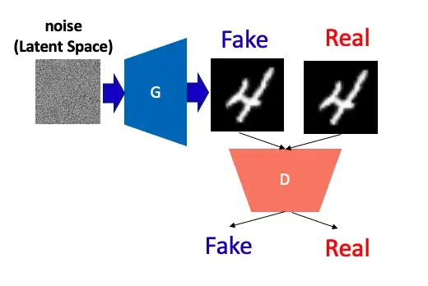
Generative Adversarial Network (GAN)
GANs achieve realism by pairing a generator
It learns to produce the target output, with a discriminator, which learns to distinguish true data from the output of the generator.
The generator tries to fool the discriminator, and the discriminator tries to keep from being fooled.

Slide 7
StyleGAN
The drawback with GAN is regulating its output i.e. replacing explicit features such as pose, face shape, and hairstyle in an illustration of a face.
The Style Generative Adversarial Network, or StyleGAN for short, is an addition to the GAN architecture that introduces significant modifications to the generator model.
StyleGAN produces the simulated image sequentially, originating from a simple resolution and enlarging to a huge resolution (1024×1024).
It transforms the input of each level individually and examines the visual features that are manifested in that level, from standard features (pose, face shape) to minute details (hair color), without altering other levels.

Slide 8
StyleGAN
The StyleGAN network has two features:
Generating high-resolution images using Progressive Growing
Incorporating image styles into each layer using AdaIN.

Slide 9
Progressive Growing
It is a method of generating high-resolution images by starting with low-resolution images and gradually adding high-resolution Generators and Discriminators.

Slide 10
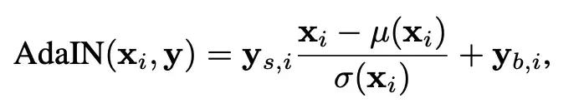
Adaptive Instance Normalization
AdaIN is different from other normalization methods such as Instance Normalization.
Here ,normalization is performed only with style and content image statistics, and no learning parameters are used.
This makes it possible to convert styles that have never been seen in training data.

Slide 11
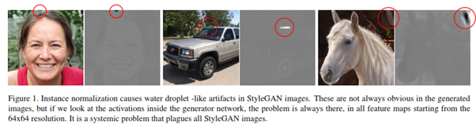
Issues with StyleGAN
Blob(Droplet) like Artifact
Resultant images had some unwanted noise which occurred in different locations.
This problem occurs due to normalization layer(AdaIN)

Slide 12
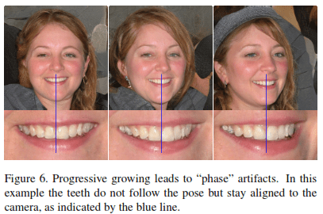
Phase artifacts
Progressive nature of GAN is flag bearer of this issue.It seems that multiple outputs during the progressive nature causes high frequency feature maps to be generated in middle layers,comprising shift invariance.

Slide 13
StyleGAN2
& Its Importance

Slide 14
Advantages of StyleGAN2
Eliminates droplet modes by normalizing with estimated statistics instead of normalizing with actual statistics like AdaIN
Uses a hierarchical Generator with skip connection instead of Progressive Growing, eye and tooth stagnation is reduced.
Improves Image quality by reducing Perceptual Path Length(PPL) and smoothing latent space

Slide 15
Architecture

Slide 16
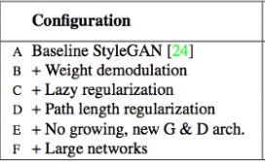
StyleGAN2 Architecture
StyleGAN2 brings up several architecture changes to rectify the issues which were faced earlier. Below are different configurations available -

Slide 17
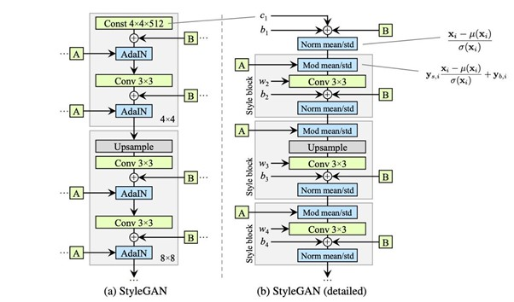
Weight demodulation
StyleGAN2 like StyleGAN uses a normalization technique to infiltrate styles from W vector using learned transform A into the source image
Now the droplet artifacts are being taken care of by Weight Demodulation. Here A and B are two inputs
where A is Affine Transformation and B is input noise assigned to each layer

Slide 18
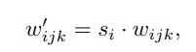
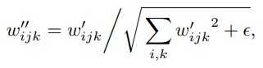
We transform each style block by two operations-
1. Combine modulation and convolution operation(Mod) by directly scaling the convolution weights rather than first applying modulation followed by convolution.
Where w_{ijk} — original weight, w_{ijk}’ — modulated weight, s_{i} — scaling value for feature map i.
2. Next is the demodulation step(Demod), here we scale the output feature map j by standard deviation of output activations (from above step) and send to convolution operation.
small ε is added to avoid numerical operation issues

Slide 19
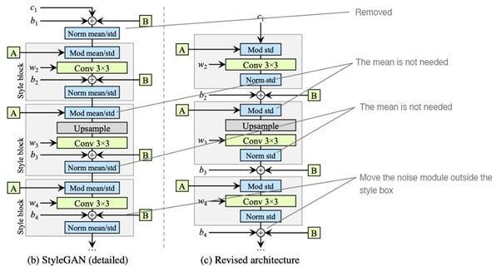
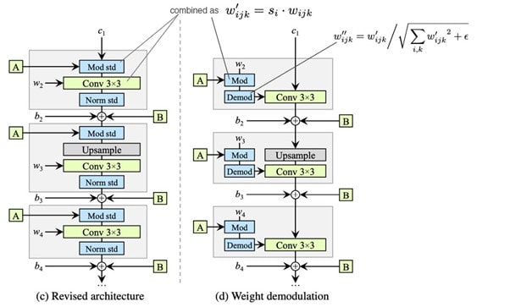
Noise and bias are removed from style block and moved outside.
We only modify standard deviation per feature map rather than both mean and standard deviation.
Next we add Demodulation module to remove the droplet artifacts.

Slide 20
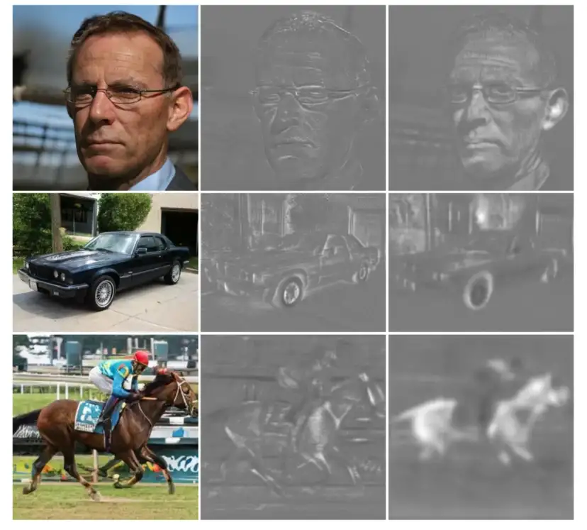
The above image shows how replacing normalization with demodulation removes the characteristic artifacts from images and activations. Droplets don’t come out using this approach.

Slide 21
2. Lazy Regularization:
StyleGANs cost function include computing both main loss function and regularization for every mini-batch.
This computation has heavy memory usage and computation cost which could be reduced by only computing regularization term once after 16 mini-batches.
This strategy had no drastic changes on model efficiency and thus was being implemented in StyleGAN2.

Slide 22
3. Path Length Regularization:
It is a type of regularization that allows good conditioning in the mapping from latent codes to images.
The idea is to encourage that a fixed-size step in the latent space W results in a non-zero, fixed-magnitude change in the image.

Slide 23
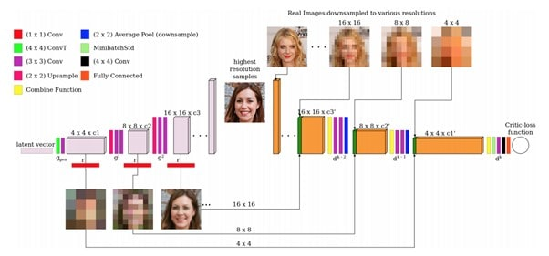
4. Removing Progressive growing:
Progressive nature of StyleGAN has attributed to Phase artifacts wherein output images have strong location preference for facial features.
StyleGAN2 tries to imbibe the capabilities of progressive growing(training stability for high-res images) and implements a new network design based on skip connection/residual nature like ResNet.
This new network does not expand to increase image resolution and yet produces the same results and is like the MSG-GAN(Multi-Scale Gradients for Generative Adversarial Networks)

Slide 24
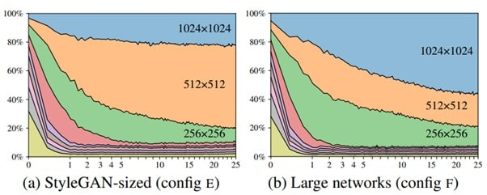
5. Large Network:
We now see the influence of high-res layers on the resultant image.
The NO GROWING,NEW G&D yields the best results for both metrics .
The below image displays contribution of different resolutions layers in training towards final output images.
The vertical axis shows the contribution of different resolution layers and horizontal axis depicts training progress.
The best Config-E for StyleGAN2 has major contribution from 512 resolution layers and less from 1024 layers. The 1024 res-layers are mostly adding some finer details.

Slide 25
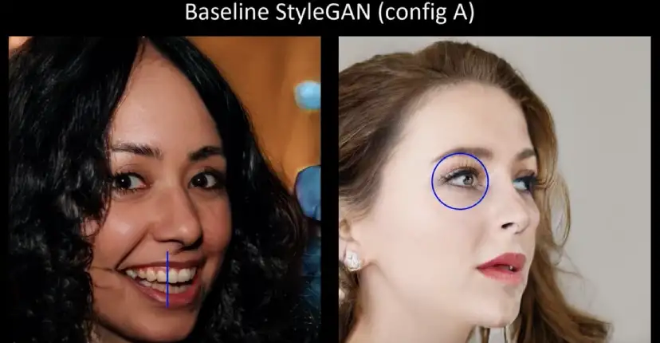
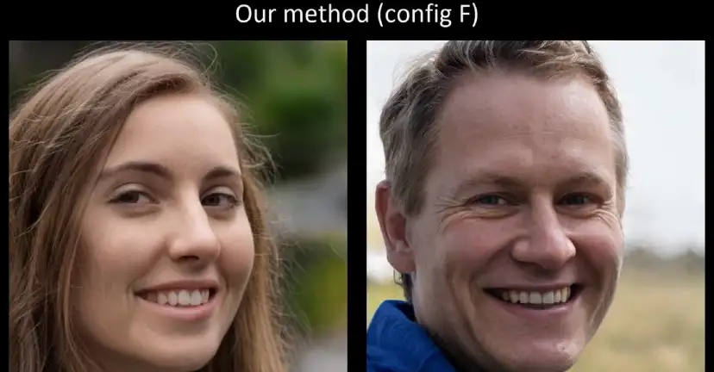
In general training flow, low-res layers dominate the output initially but eventually it is the final high-res layers that govern the final output.
In Config-E(NO GROWING,NEW G&D ), 512 res-layers seem to have more contribution and thus it impacts the output too.
To get more finer results from the training, we need to increase the capacity of 1024 res-layers such that they contribute more to the output.
Config-F is considered a larger network that increases the feature maps in high-res layers and thus impacts the quality of resultant images.
The eyes and teeth become unnatural in StyleGAN, while the new mechanism shows that the eyes and teeth move naturally with the change of the face direction.

Slide 26
Results & Evaluation Metrics

Slide 27
Frechet Inception Distance (FID)
It is a measure of how close the distribution of the generated image is to the that of the original image.
However, since the images are embedded in a high-dimensional space, the distance of the distribution cannot be easily measured.
Therefore, the basic concept of FID is to have the image embedded in a low-dimensional space using a recently developed image recognition model whose accuracy exceeding humans, and to measure the distribution distance in that space.

Slide 28
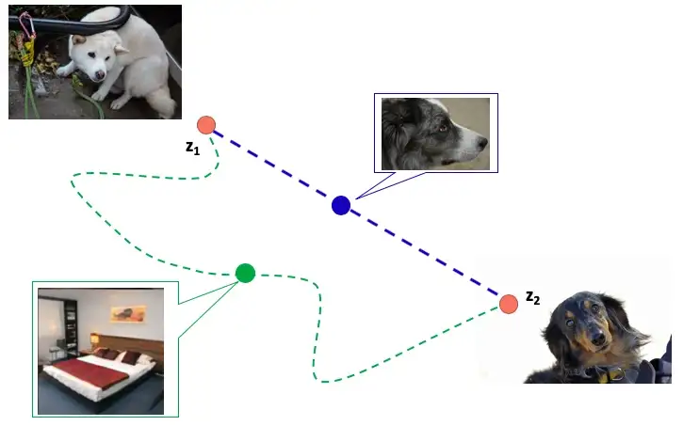
Perceptual Path Length (PPL)
It is an indicator of whether the image changes smoothly in “perceptual”. Uses the distance of the image embedded in the trained model, similar to FID.Roughly speaking, it indicates whether the image changes on the shortest “perceptual” path in the latent space that is seed of fake images” .

Slide 29
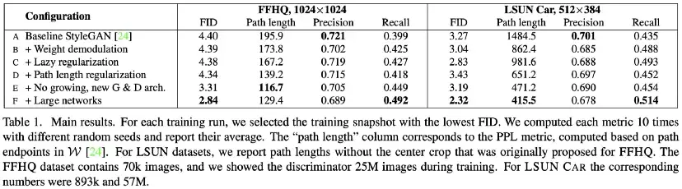
The learning time became faster by incorporating Lazy regularization and AdaIN inside the convolution (37 → 61 images / sec), and they could scale up the network further .

Slide 30
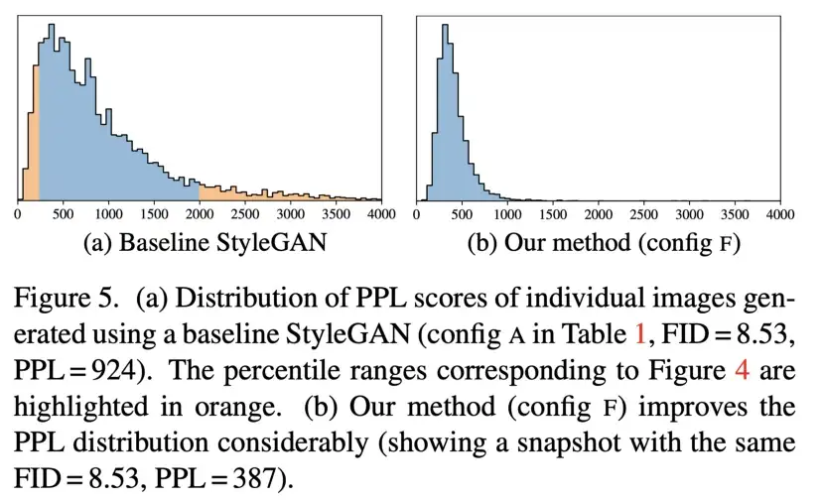
The smaller PPL indicate better quality of the generated image.
Therefore from the histogram we can conclude that the styleGAN2’s images quality are improved.

Slide 31
About the Dataset
Flickr-Faces-HQ Dataset (FFHQ)
Flickr-Faces-HQ (FFHQ) consists of 70,000 high-quality PNG images at 1024×1024 resolution
Contains considerable variation in terms of age, ethnicity and image background.
It also has good coverage of accessories such as eyeglasses, sunglasses, hats, etc

Slide 32
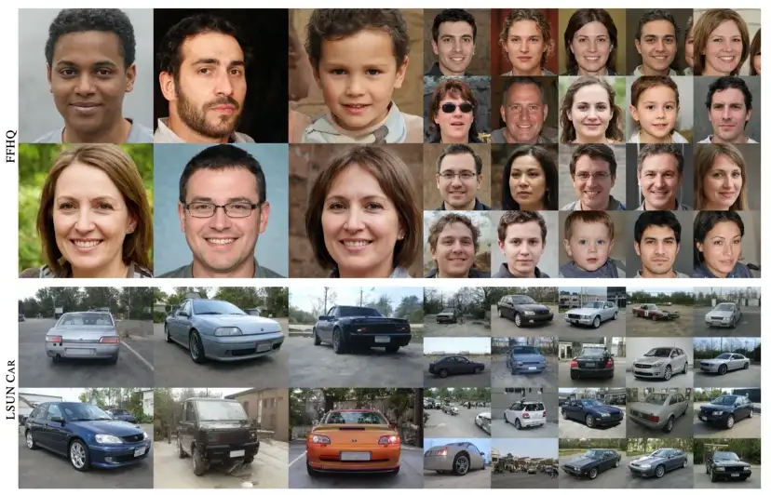
Images generated from StyleGAN2

Slide 33
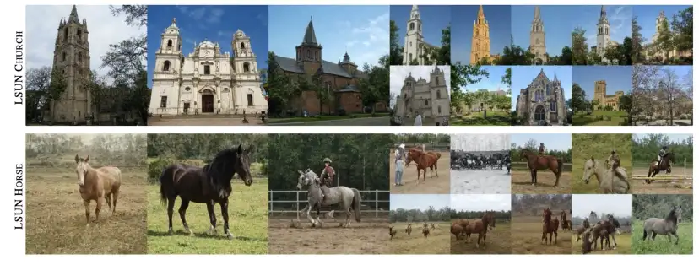
Images generated from StyleGAN2

Slide 34
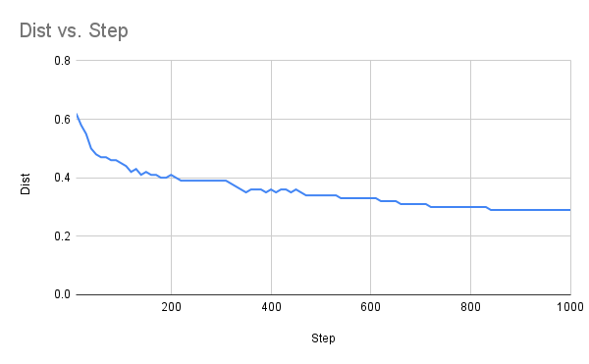
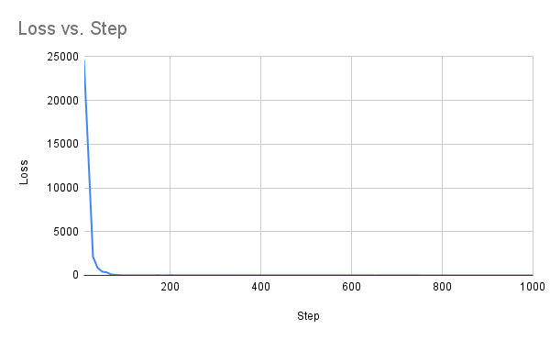
Learning Curves for Source GAN
FID Curve
Loss Curve
loss = dist + reg_loss * regularize_noise_weight

Slide 35
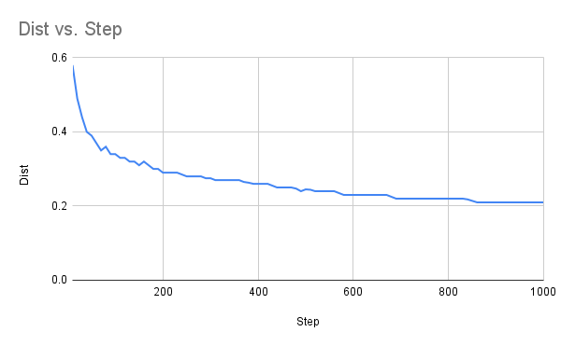
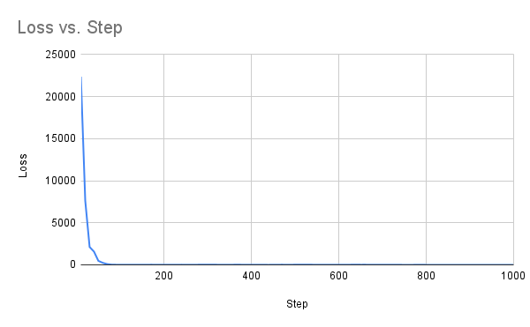
Learning Curves for Target GAN
FID Curve
Loss Curve

Slide 36
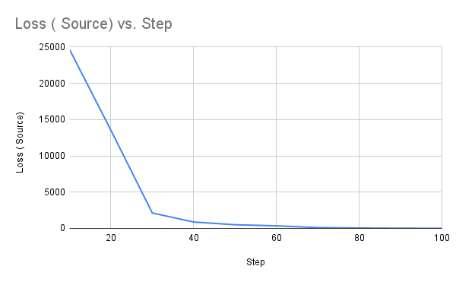
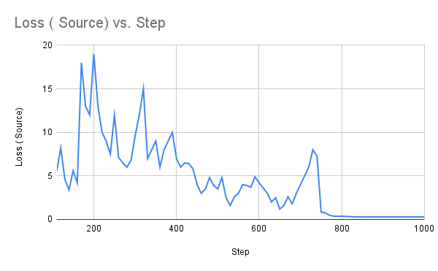
Loss Curves (Enlarged)
Source GAN
100
Steps (1-100)
Steps (100-1000)

Slide 37
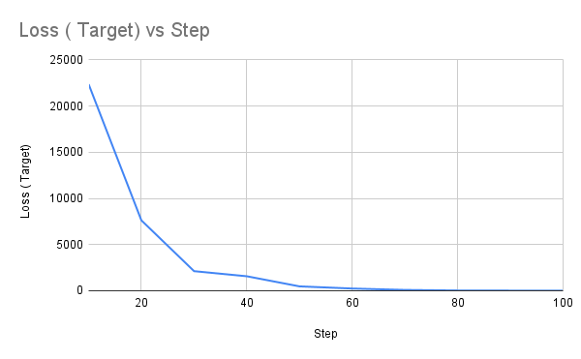
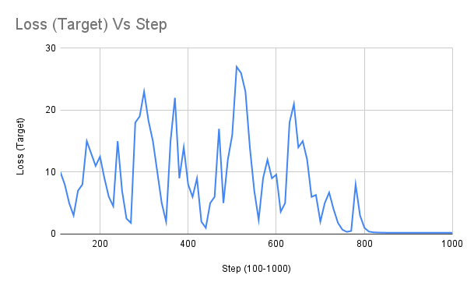
Target GAN
100
Steps (1-100)
Steps (100-1000)

Slide 38
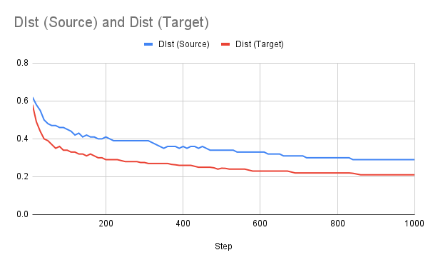
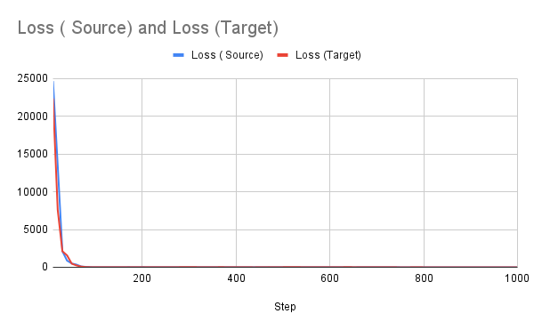
Comparing Curves for Source GAN and
Target GAN
FID Curve
Loss Curve

Slide 39
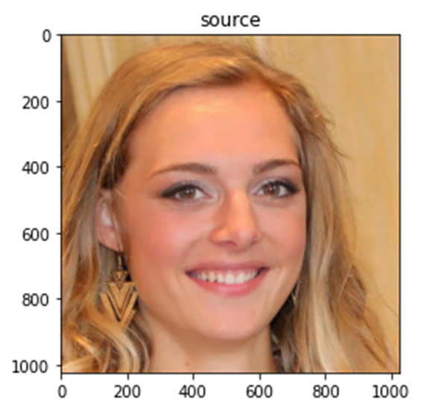
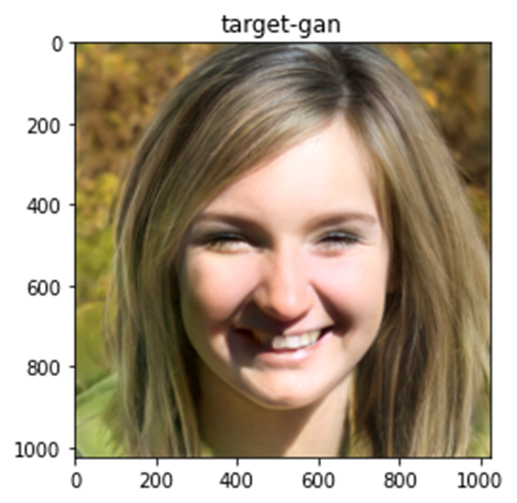
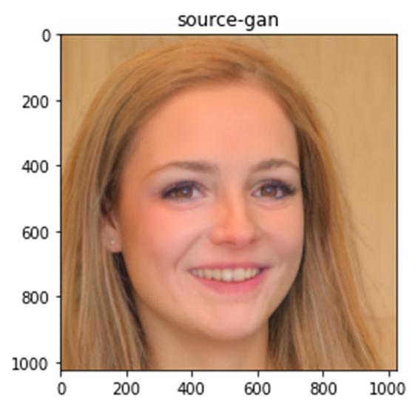
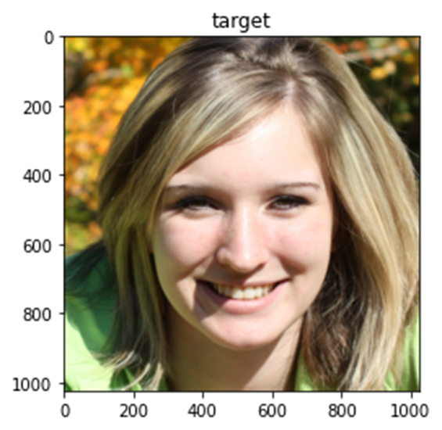
Implementation- Example 1
Source
Target
Source GAN
Target GAN

Slide 40
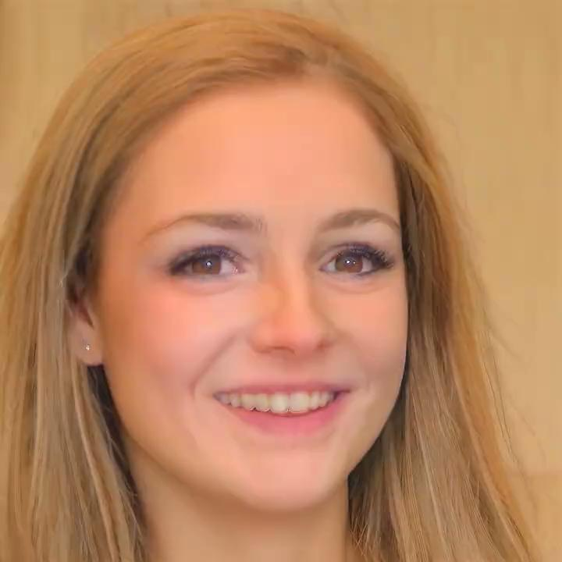
Example-1 Video

Slide 41
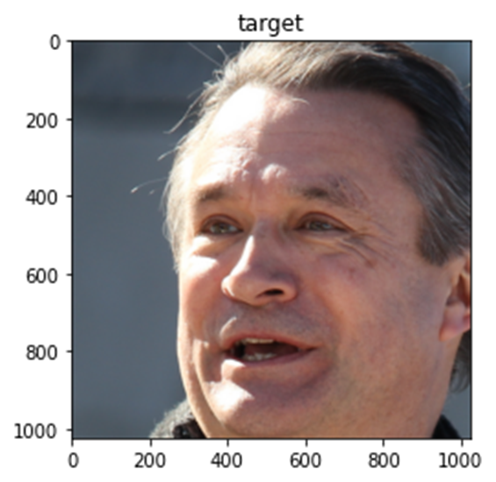
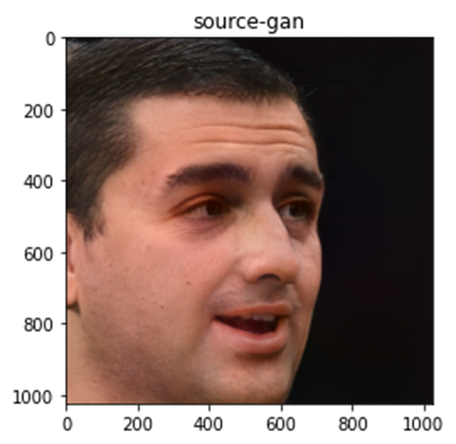
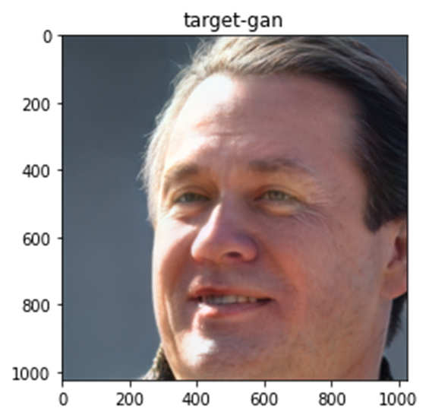
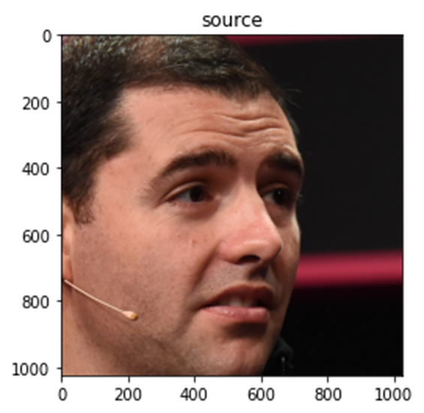
Implementation- Example 2
Source
Target
Source GAN
Target GAN

Slide 42
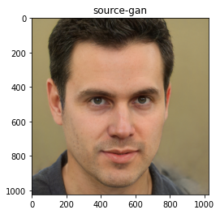
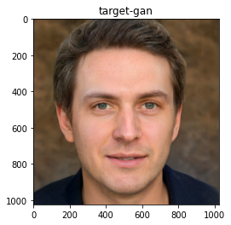
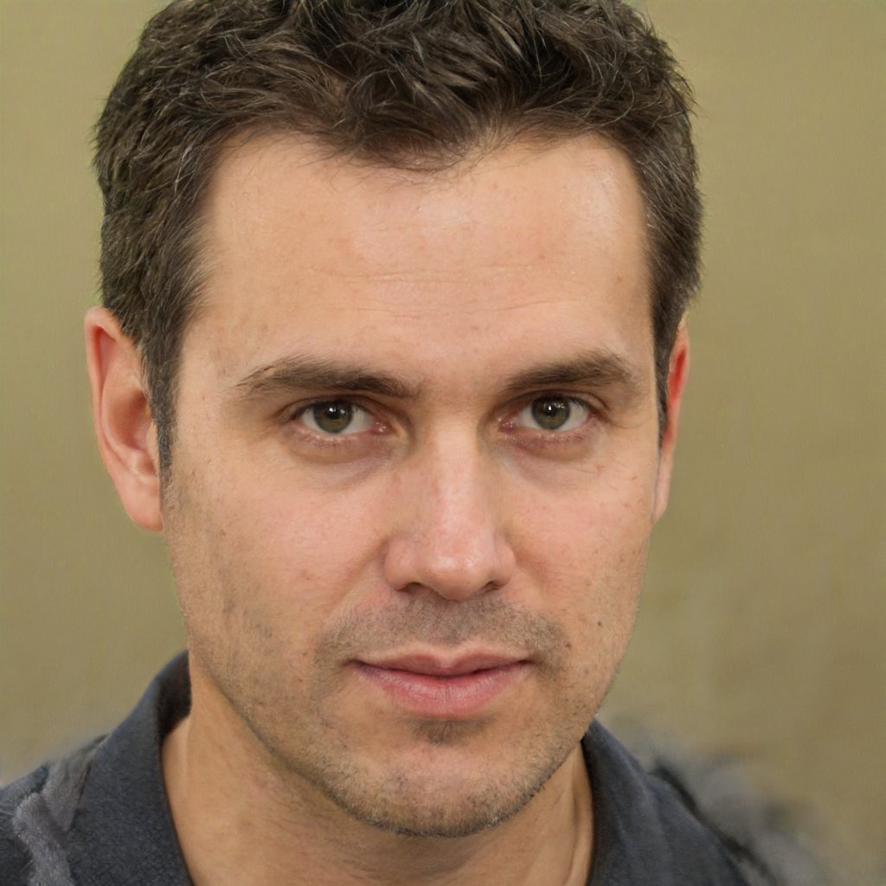
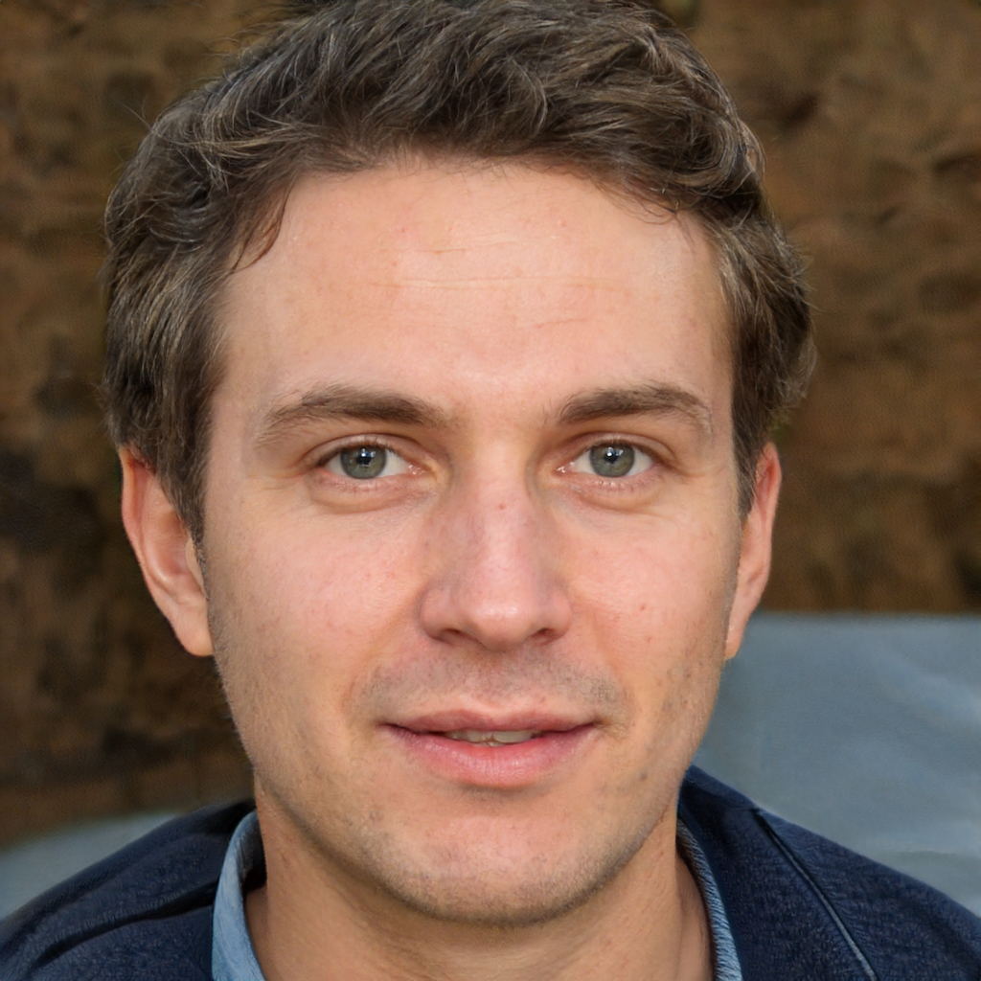
Implementation- Example 3
Source
Target
Source GAN
Target GAN

Slide 43
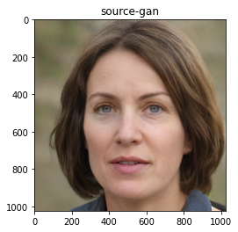
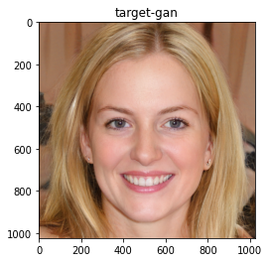
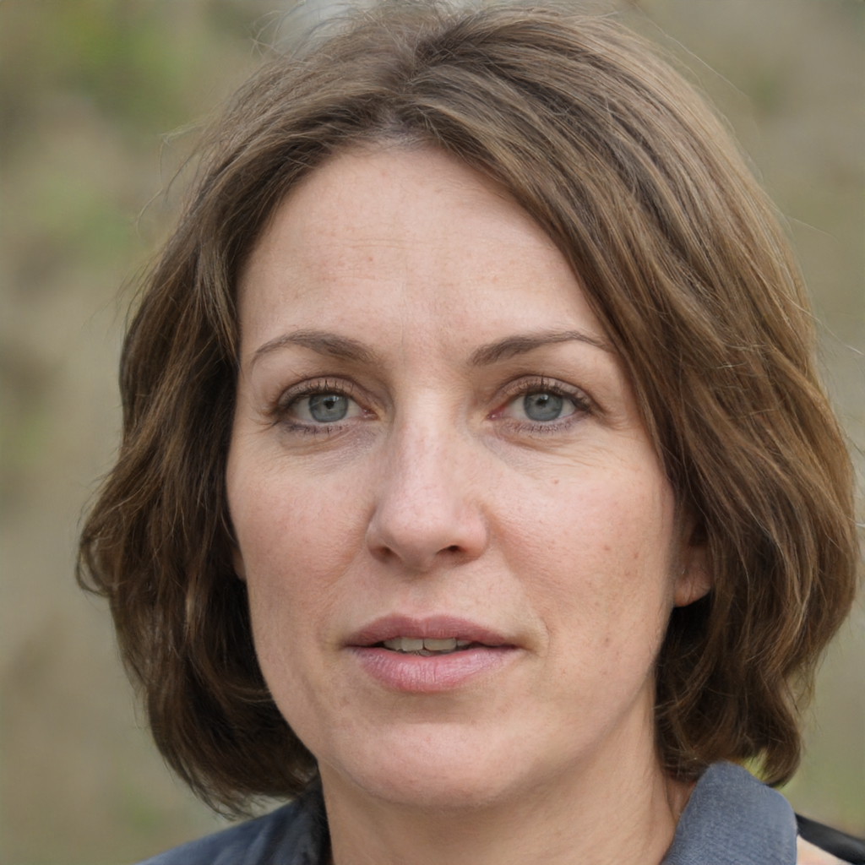
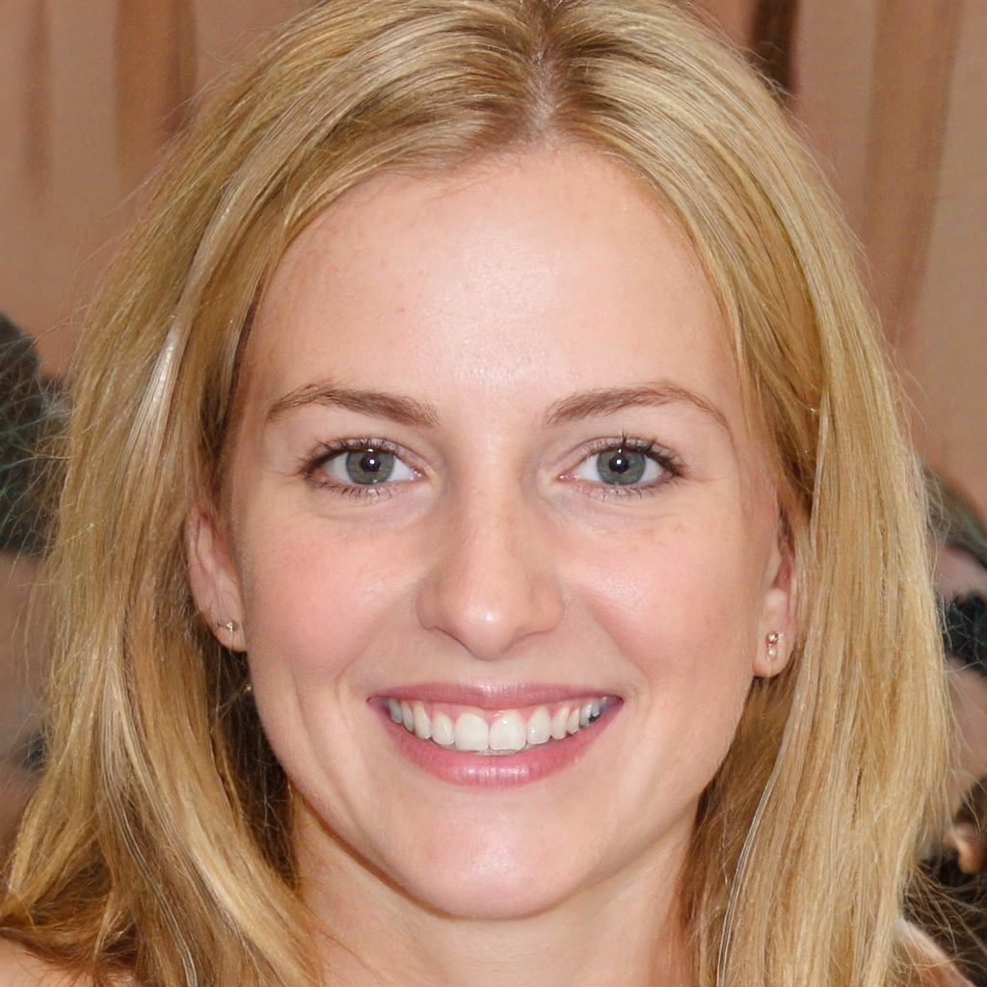
Implementation- Example 4
Source
Target
Source GAN
Target GAN

Slide 44
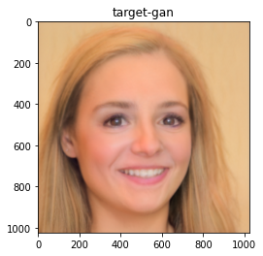
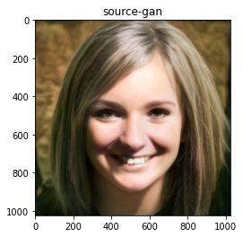
Difference in Images with and without Skip Connections
With Skip Connection
Without Skip Connection
Source Gan
Target Gan
Source Gan
Target Gan

Slide 45
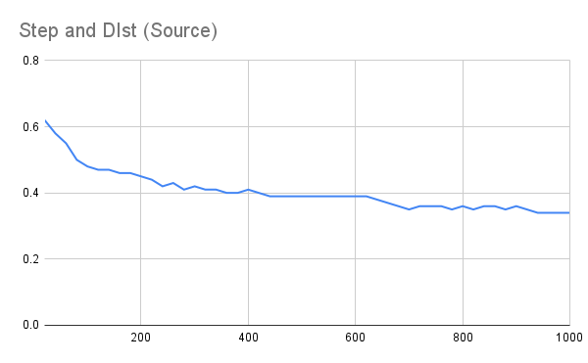

Learning Curves Without Skip Connection
Source GAN
FID Curve
Loss Curve

Slide 46


Target GAN
FID Curve
Loss Curve

Slide 47


Comparing Learning Curves With and Without Skip Connection
FID Curve
Loss Curve

Slide 48
Limitations of StyleGAN2
StyleGAN2 (config F, larger networks) trains at 31 img/s, and therefore it is slightly more expensive to train than original StyleGAN.
Even with 8 GPUs (V100), it costs 9 days for FFHQ dataset and 13 days for LSUN CAR dataset.
Texture sticking issue happens while morphing one face from another face. This problem is resolved in StyleGAN3.

Slide 49

Texture Sticking Problem
Issue happens in morphing transition (eg morphing from one face to another.)
The average of images is sharp in StyleGAN2 as many details stick to same pixel coordinates, while the intended result should be uniformly blurry because all details should move together when morphing

Slide 50
Future scope
It could be fruitful to study further improvements to the path length regularization, e.g., by replacing the pixel-space L2 distance with a data-driven feature-space metric
It will be important to find new ways to reduce the training data requirements.This is especially crucial in applications where it is infeasible to acquire tens of thousands of training samples, and with datasets that include a lot of intrinsic variation.

Slide 51
Thank You

